Slide 1
Advanced Leopard Seal Recognition System (ALSRS): Sprint 4
Bryce Robinson, Carson Buntin, Carsyn Smeda, Nathan Hontz, Juncheng Li, Ryan Huntington, Omar Darwish
Seal Team 6 (7?)
Notes:
Carsyn

Slide 2
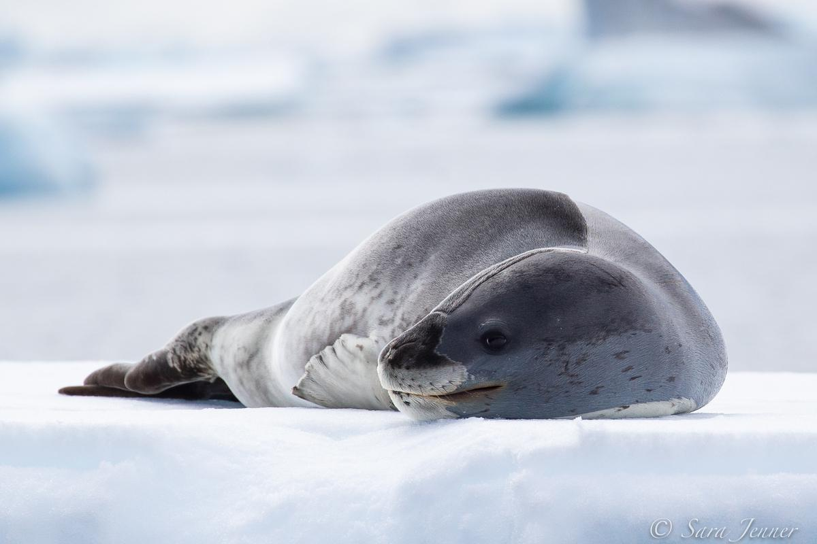
Project Review
Current lack of effective tools to detect and identify individual leopard seals
Develop API for Happywhale.com capable of receiving leopard seal photographs and returning the identity of any recognized seals
Utilization of two machine learning models for detection and identification of leopard seals
Notes:
Carsyn

Slide 3
Progress Review
Detection Model
Competitor: YOLO
Mask RCNN
Faster RCNN
Identification Model
Competitor: ViT
DEiT
EfficientNet
API
Correspondence with Happywhale on architecture
Models able to be called from Java via Python script
Endpoints for detecting leopard seals and preprocessing images
Notes:
Carsyn

Slide 4
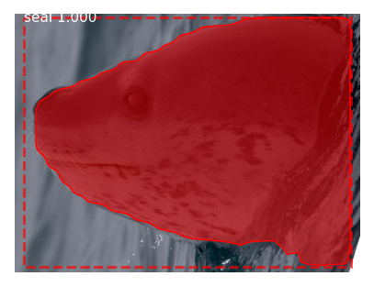
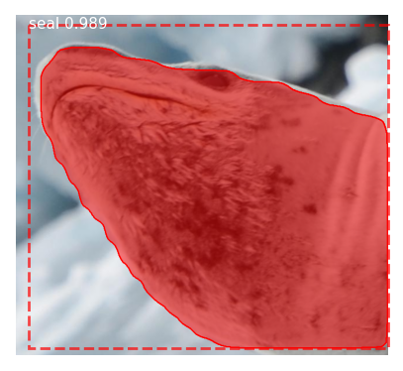
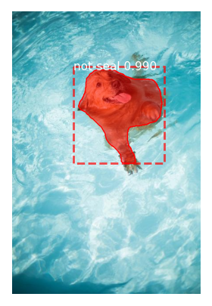
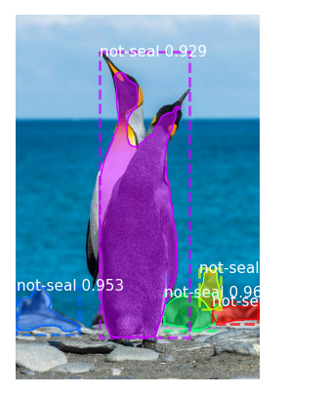
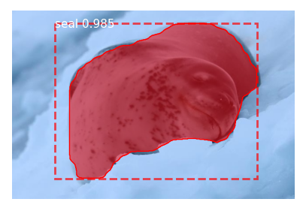
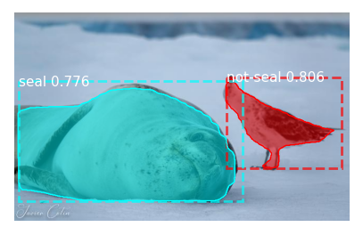
Mask-RCNN Improved Results
New non-seal masked data helps improve detection of both seals and non-seals
mAP (mean average precision) score of 0.88
Notes:
Omar
mAP- compares predicted bounding box to actual bounding box, 0.88 is relatively high but could be improved by fine tuning the hyper parameters
Much improvement with newly annotated data since non-leopard seals are actually detected

Slide 5
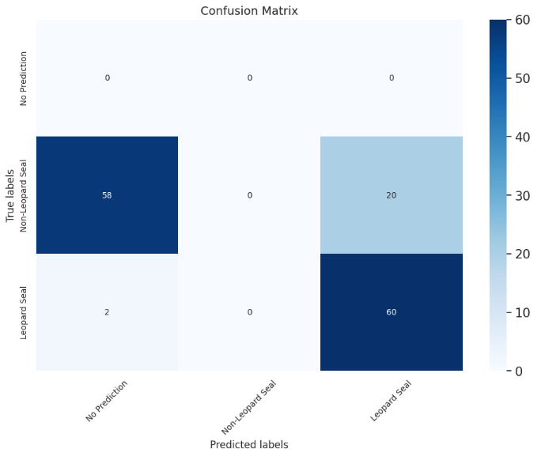
Faster RCNN Results
Testing Dataset:
100 Images of Leopard seals and non-leopard seals
62 objects are Leopard seals
78 objects are non-leopard seals
Notes:
Juncheng

Slide 6
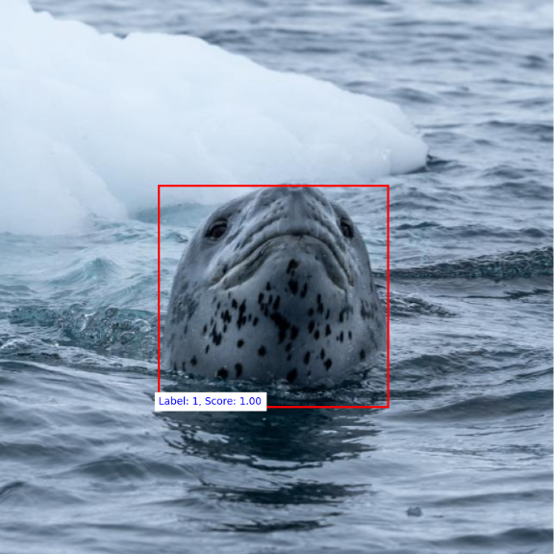
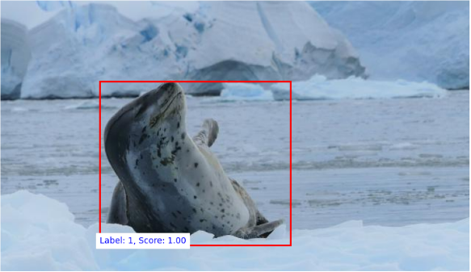
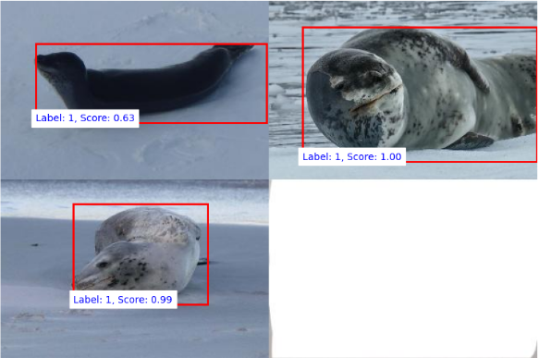
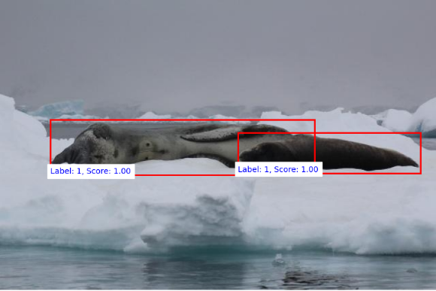
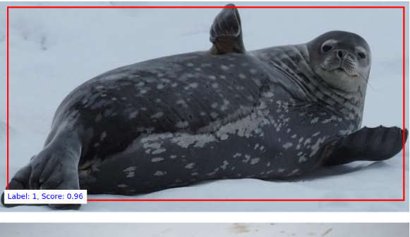
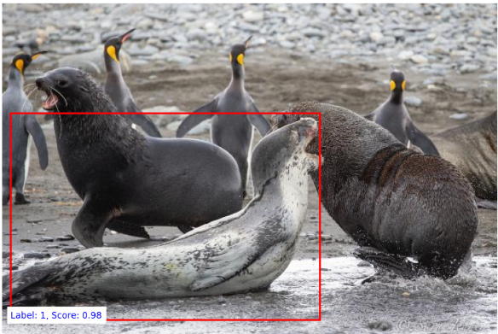
Images that Faster RCNN Performed Well

Slide 7
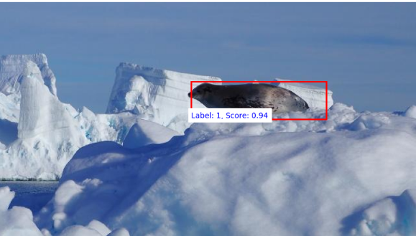
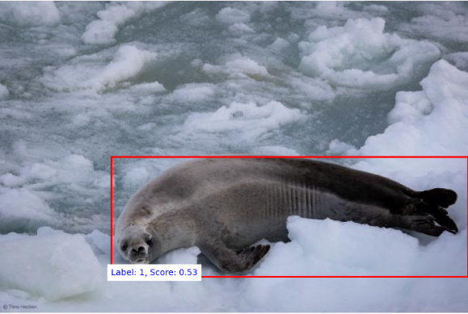
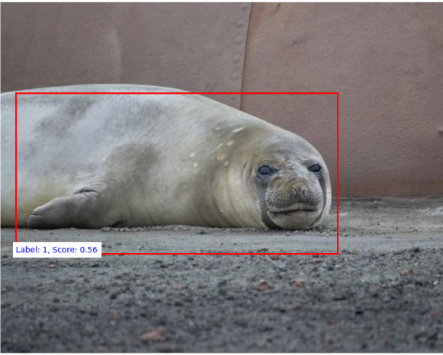
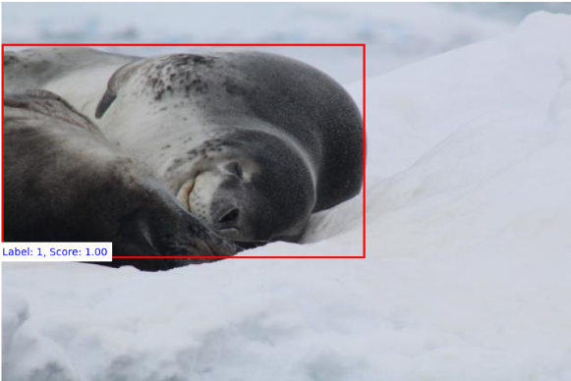
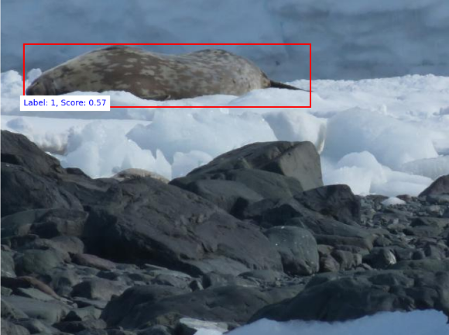
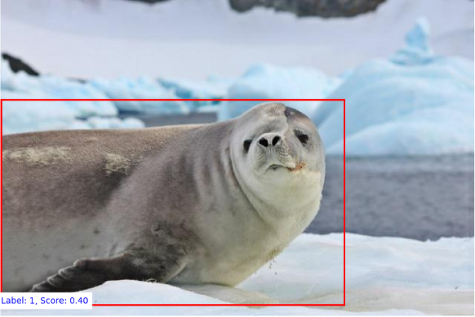
Images that Faster RCNN Performed Poorly

Slide 8
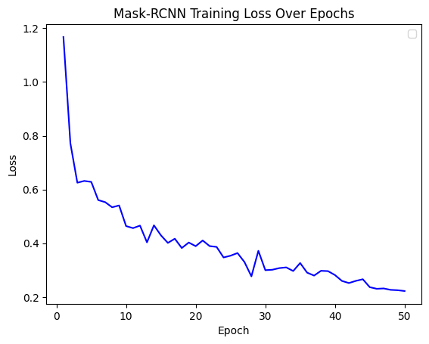
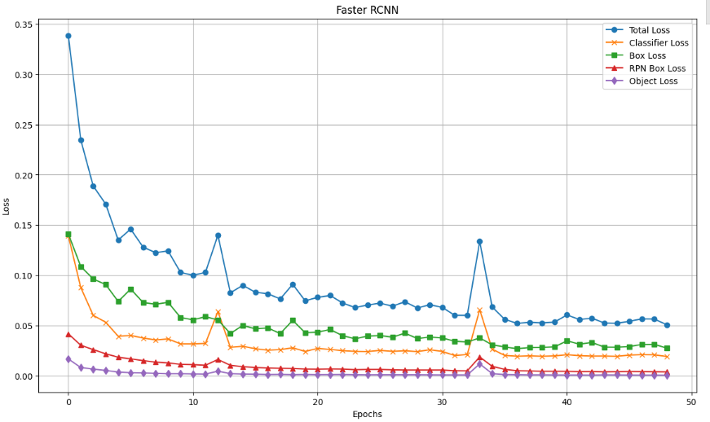
Training Loss Plots for Both Models
Mask RCNN
Faster RCNN
Notes:
Omar and Juncheng

Slide 9
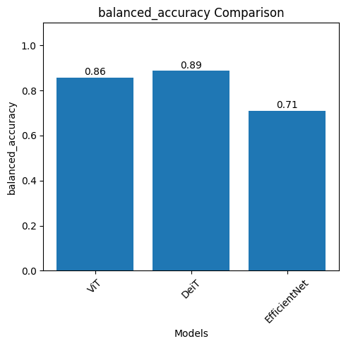
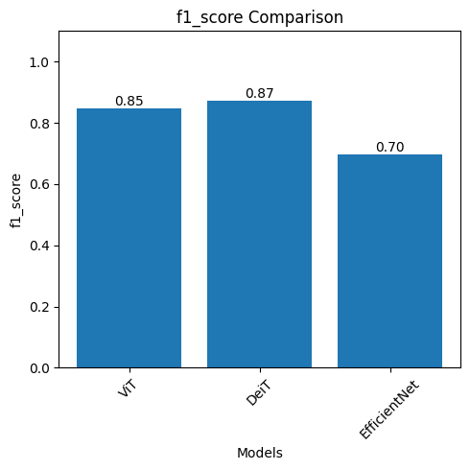
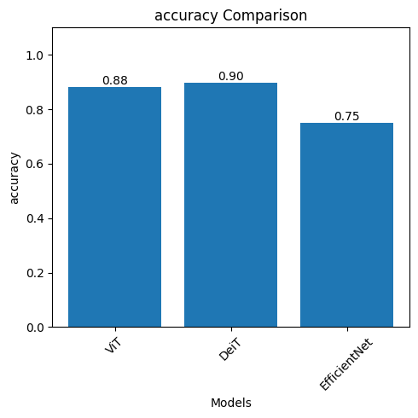
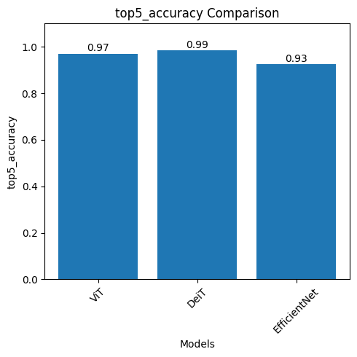
DeiT vs EfficentNet
Final comparison between identification models
Unable to improve performance of EfficientNet to comparable degree
Focus full effort into one model
Notes:
Ryan

Slide 10
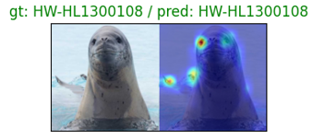
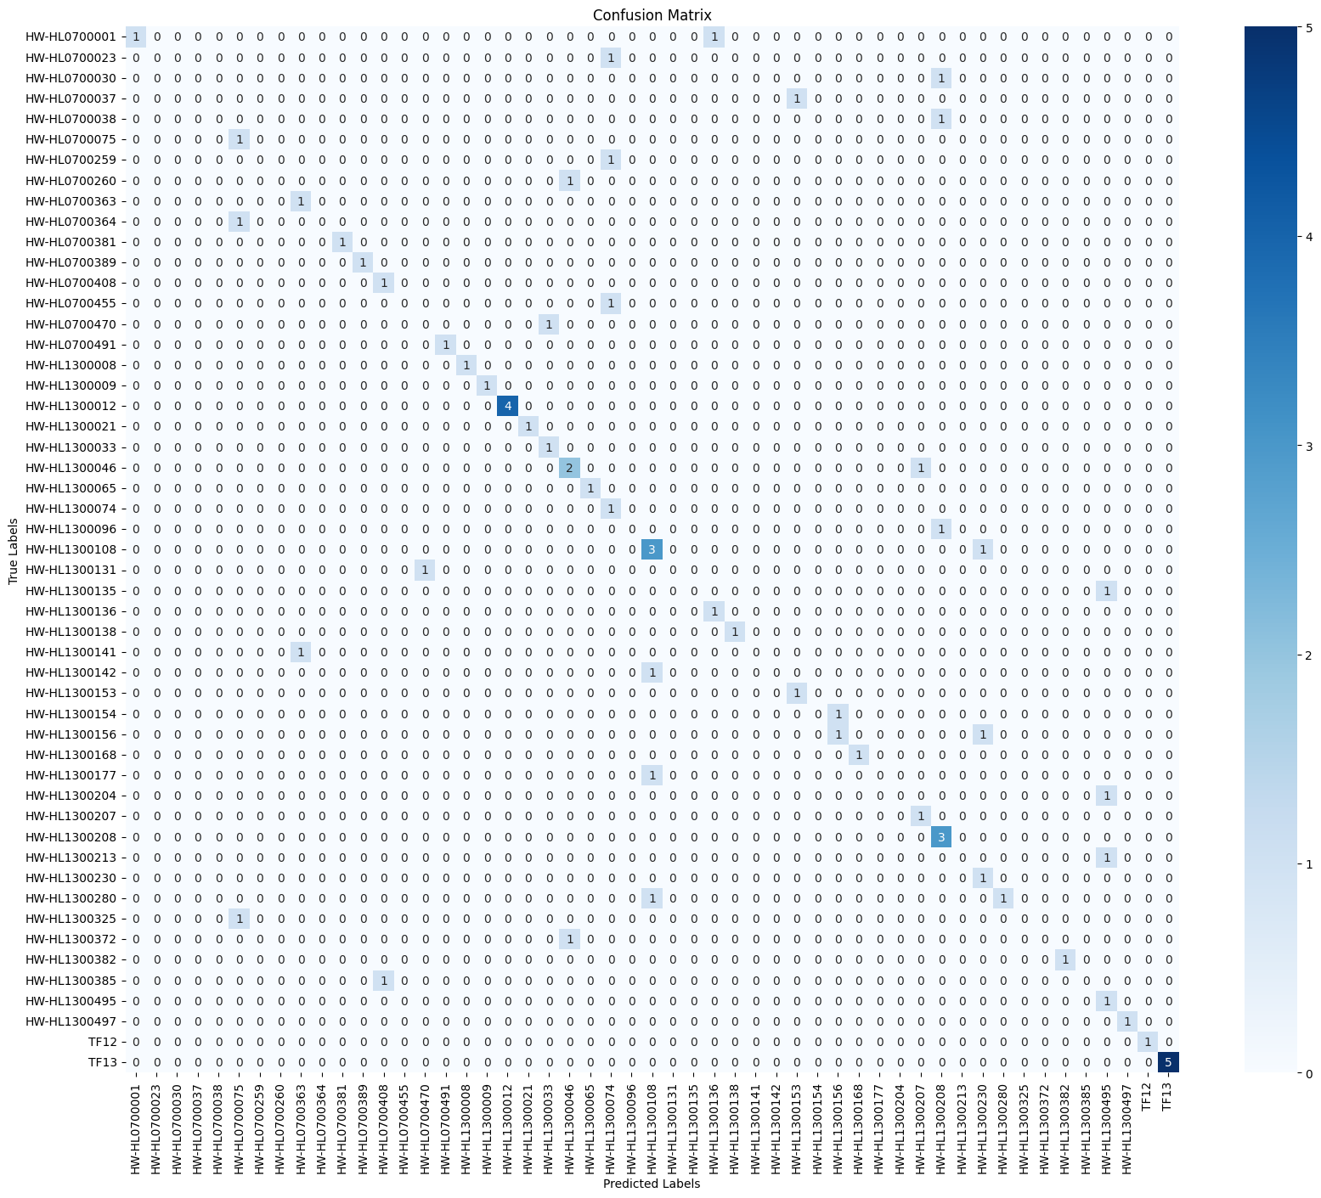
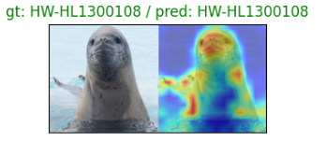
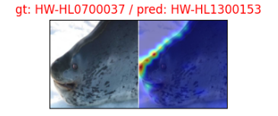
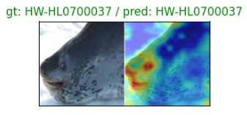
Feature Extractor
Notes:
Ryan

Slide 11
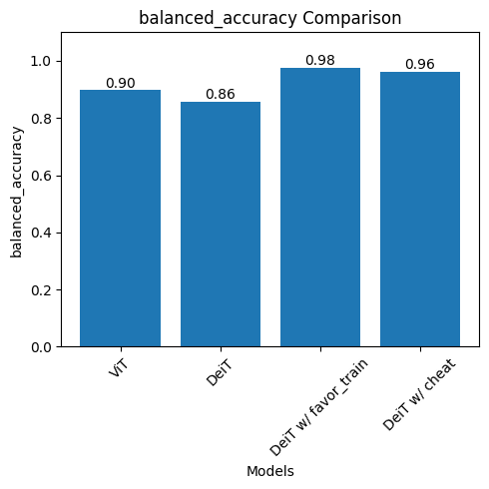
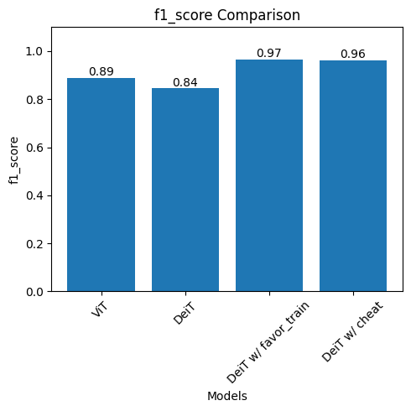
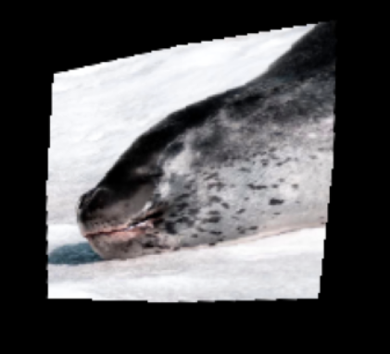
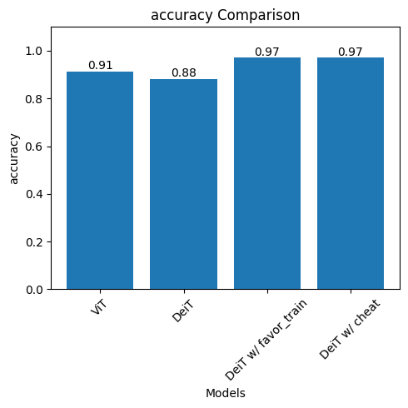
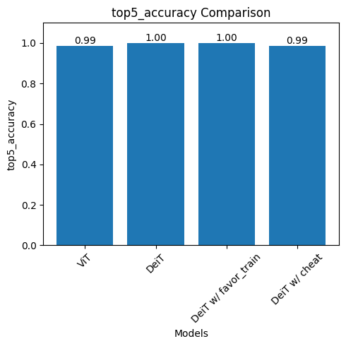
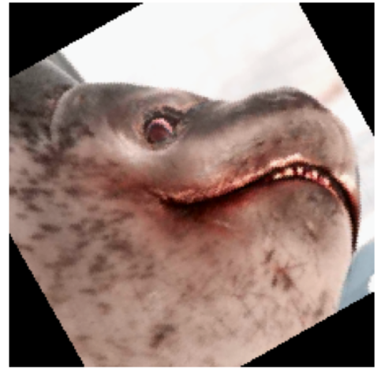
Data Augmentation
Updating script for augmentations
If low amount of images
Put all images in train
Put all images in test
Create copies of images with rotation and spread through test and train
Included with
Rotation
Perspective
Color jitter
Cutout
Salt -and-pepper noise
Notes:
Ryan

Slide 12
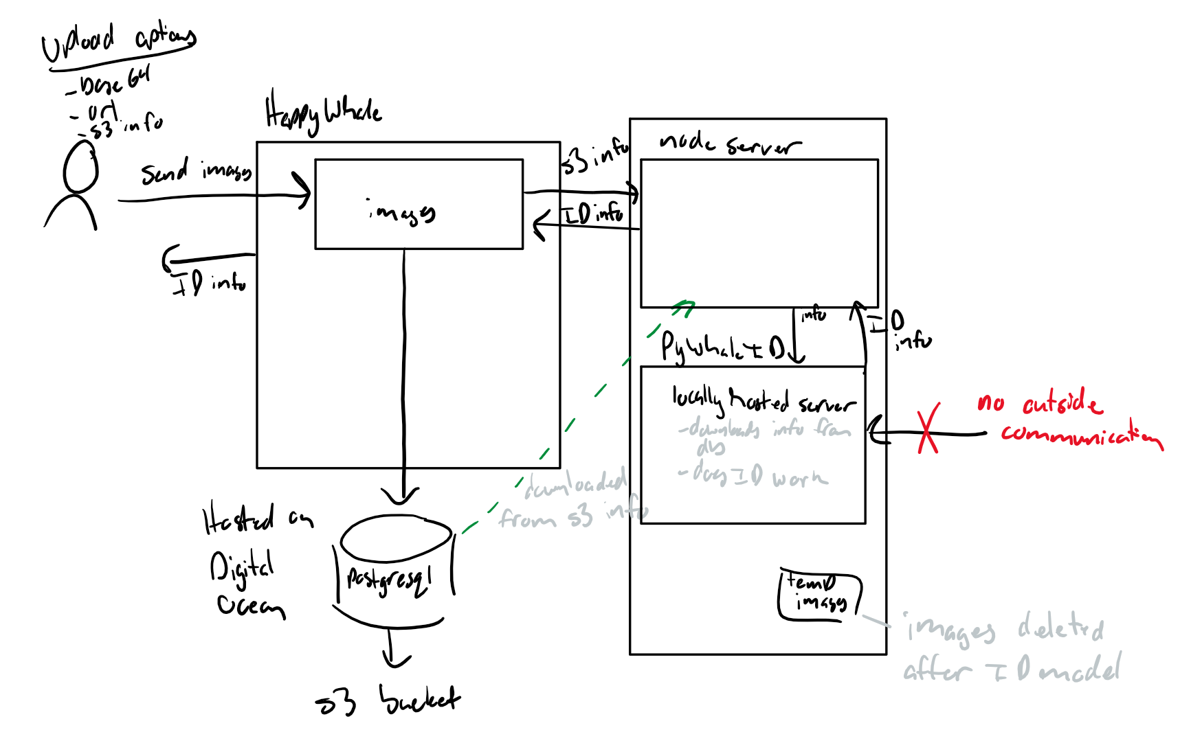
API Progress
Updating API to match HappyWhale Architecture
URL and S3 implementations in addition to base64
Migrated project to Spring Boot to run API locally
Notes:
Carson

Slide 13
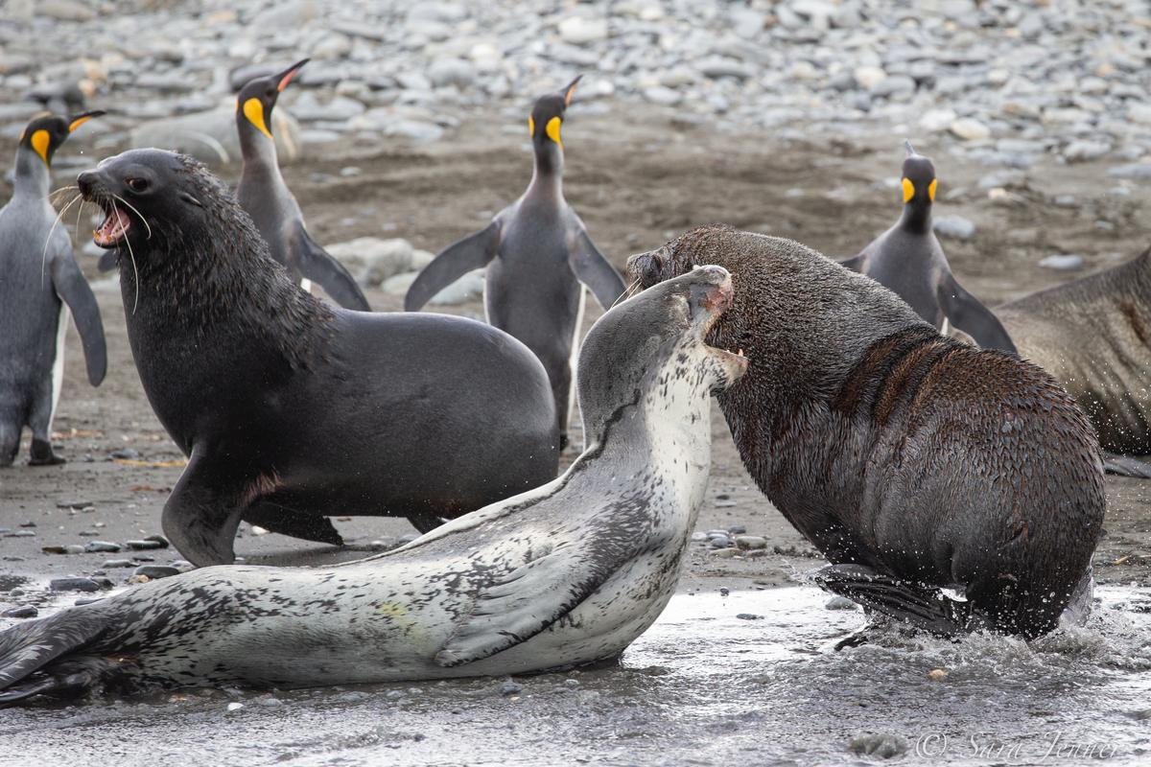
API Progress
Added application.yaml file to store script names, log file, and database connection information
Formatted model output to a simple bounding box format
Added support for model script to run on multiple images in a batch
Notes:
Bryce

Slide 14

Notes:
Bryce

Slide 15
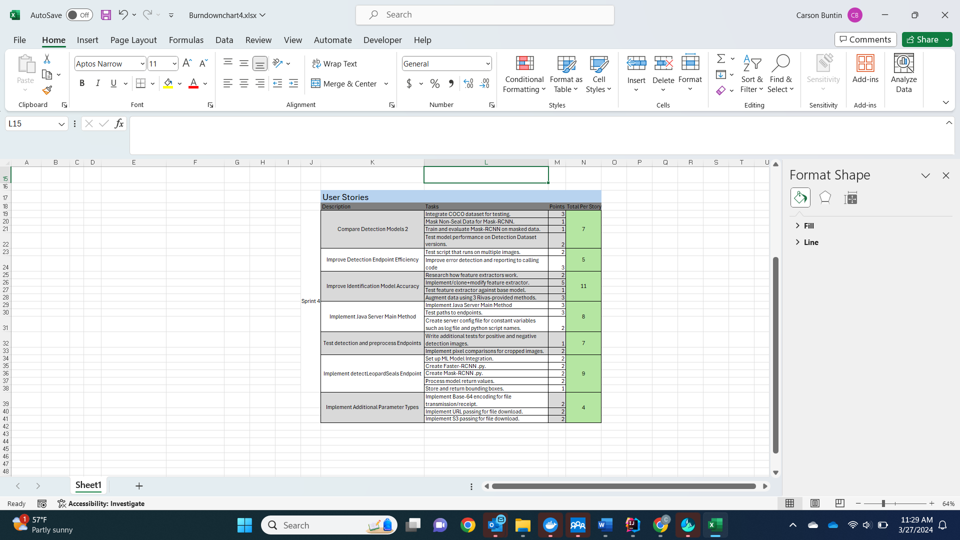
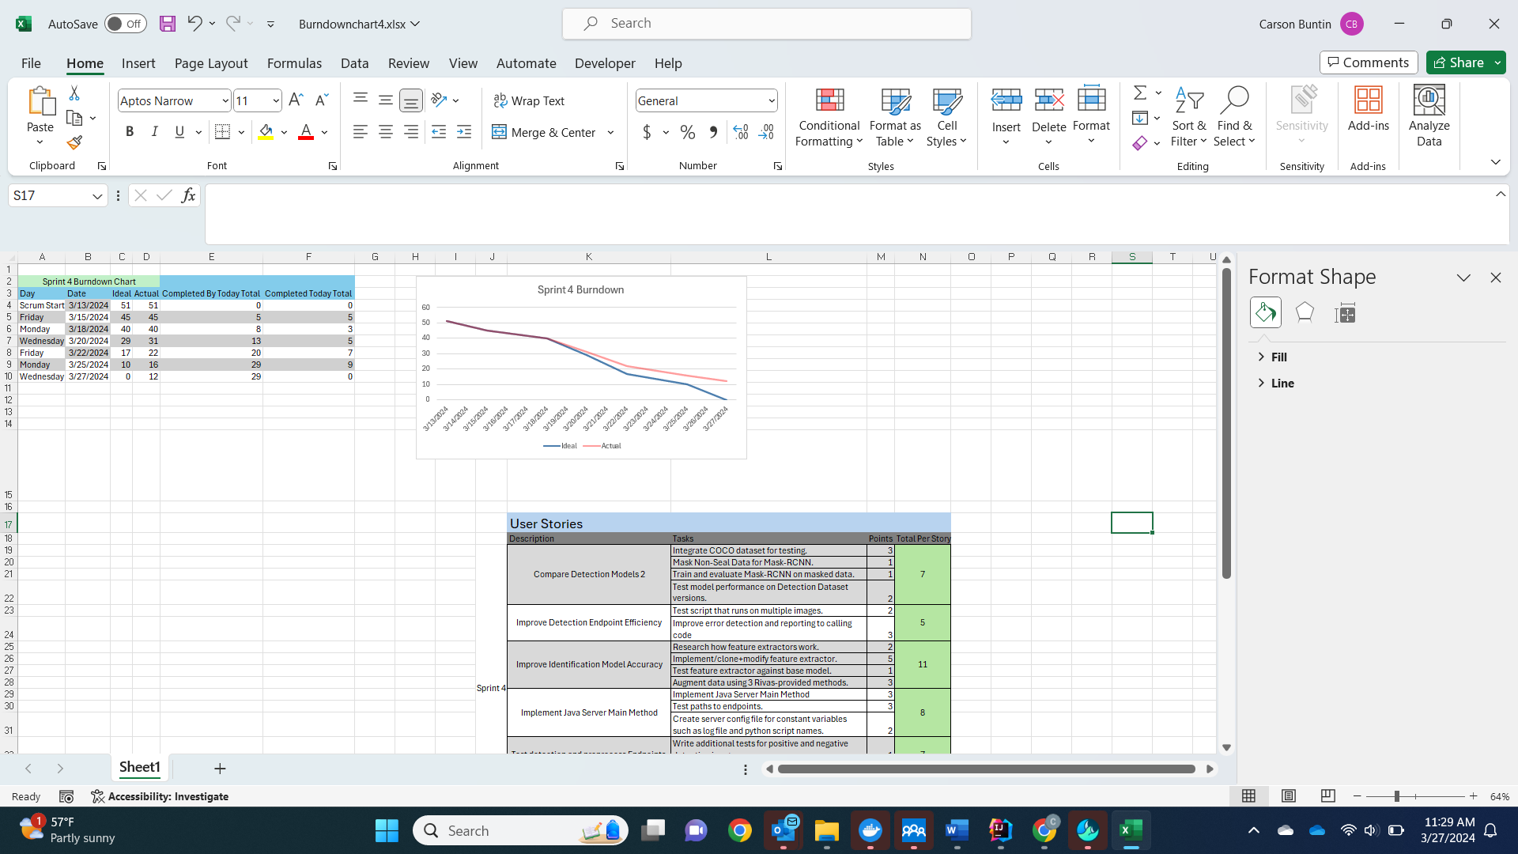
Burndown Chart and User Stories
Notes:
Carson

Slide 16
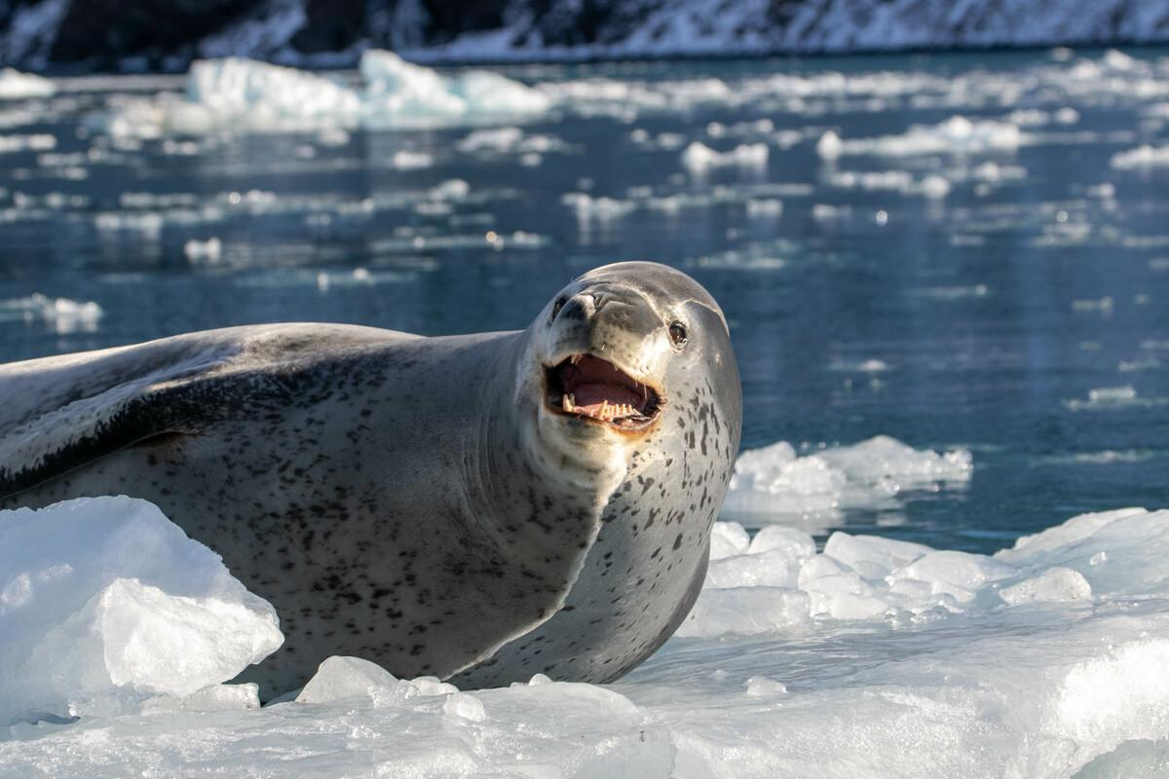
Next Sprint
Determine identification model functionality when an unfamiliar seal is passed in
Begin integration of DEiT to our API
Refactor python code to match Happywhale-provided interface
Notes:
Bryce

Slide 17
Questions

